Slide 1
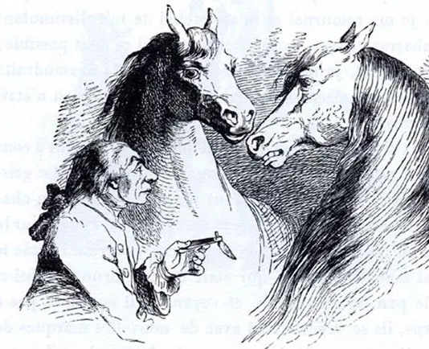
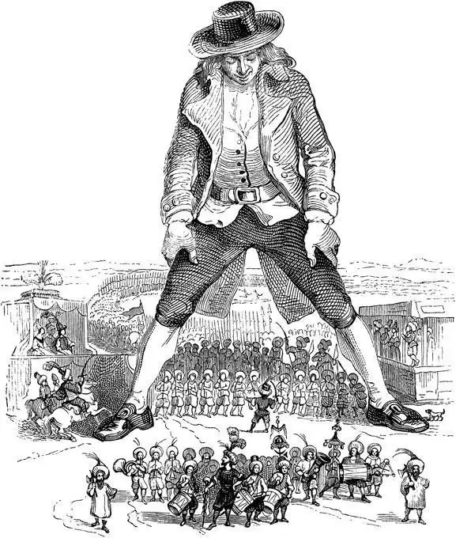
An introduction to Gulliver's Travels
——A sharp appeal to reason
in a time of chaotic
*** ***

Slide 2
Chapter 4 :
A Voyage to the Houyhnhnms
CONTENTS
Part 1
Content introduction
Multiculturalism and cultural difference
Part 2
Part 3
Feelings and comments

Slide 3
01
Content introduction
A VOYAGE to the Houyhnhnms Chapter X p.147-156

Slide 4
Content introduction
Summary
In Houyhnhnms, Gulliver met Yahoos and Houyhnhnms. The former species regarded Gulliver as their fellows, but Gulliver preferred to live with the wiser Houyhnhnms and had acquired lots of knowledge during their discussion in this trip. Also, he started to hate Yahoos and even human after further understanding their bad qualities. However, the representatives’ disapproval of keeping a Yahoo in a Houyhnhnm’s family forced Gulliver to leave their country. Gulliver left the Houyhnhnms with great grief at last and refused to cope with the rest of humanity.

Slide 5
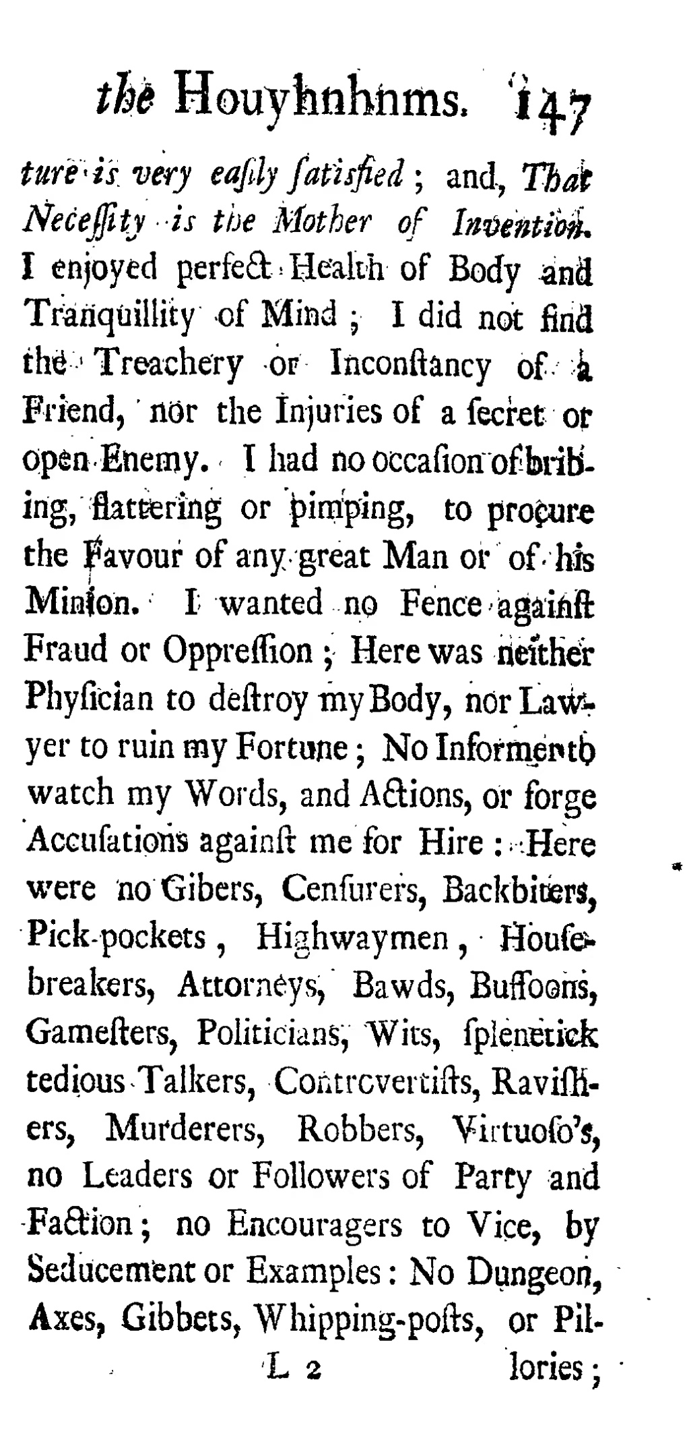
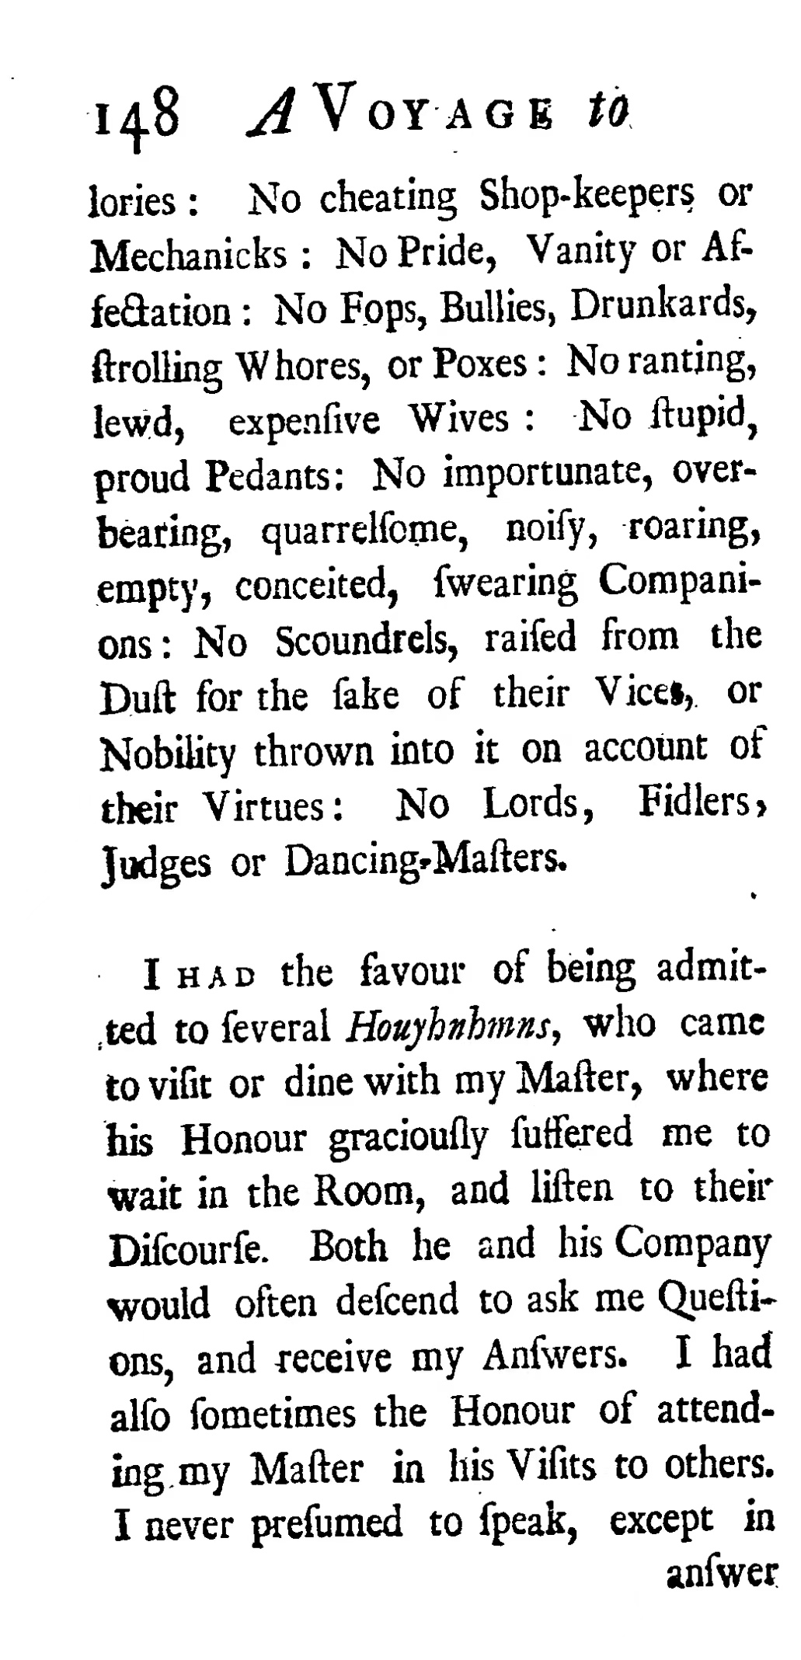
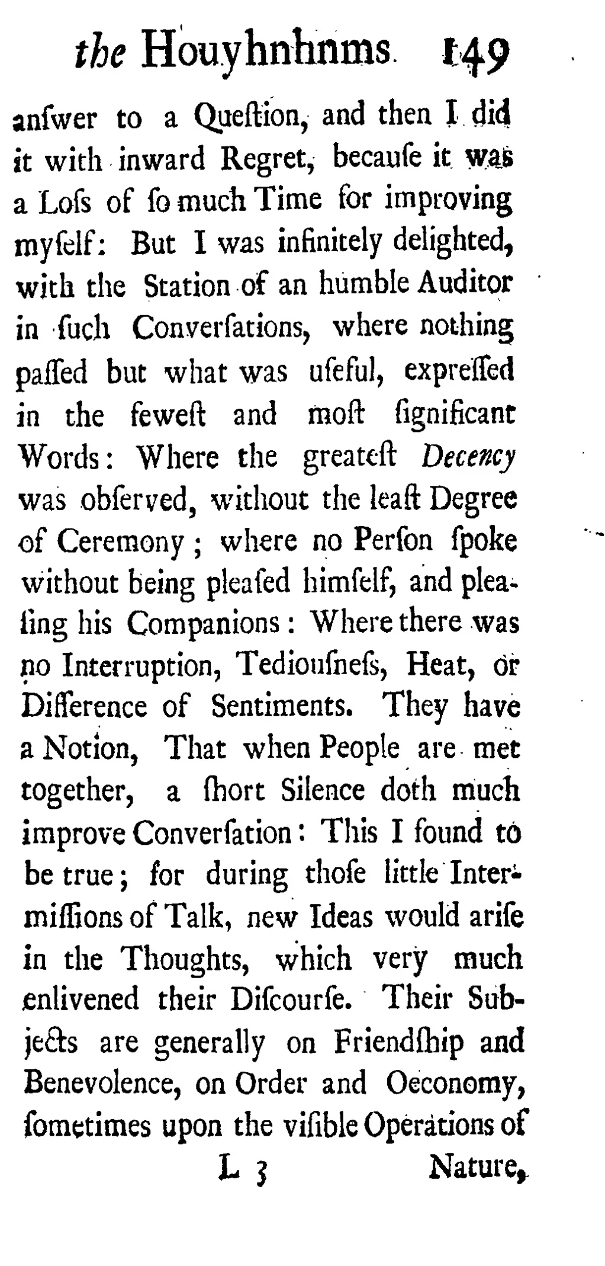
Content introduction
P147-149
Gulliver’s bad impression of human

Slide 6
Content introduction
P147-149
Gulliver enjoyed discussing with those reliable horses
because it’s not easy to completely trust someone in human society.

Slide 7
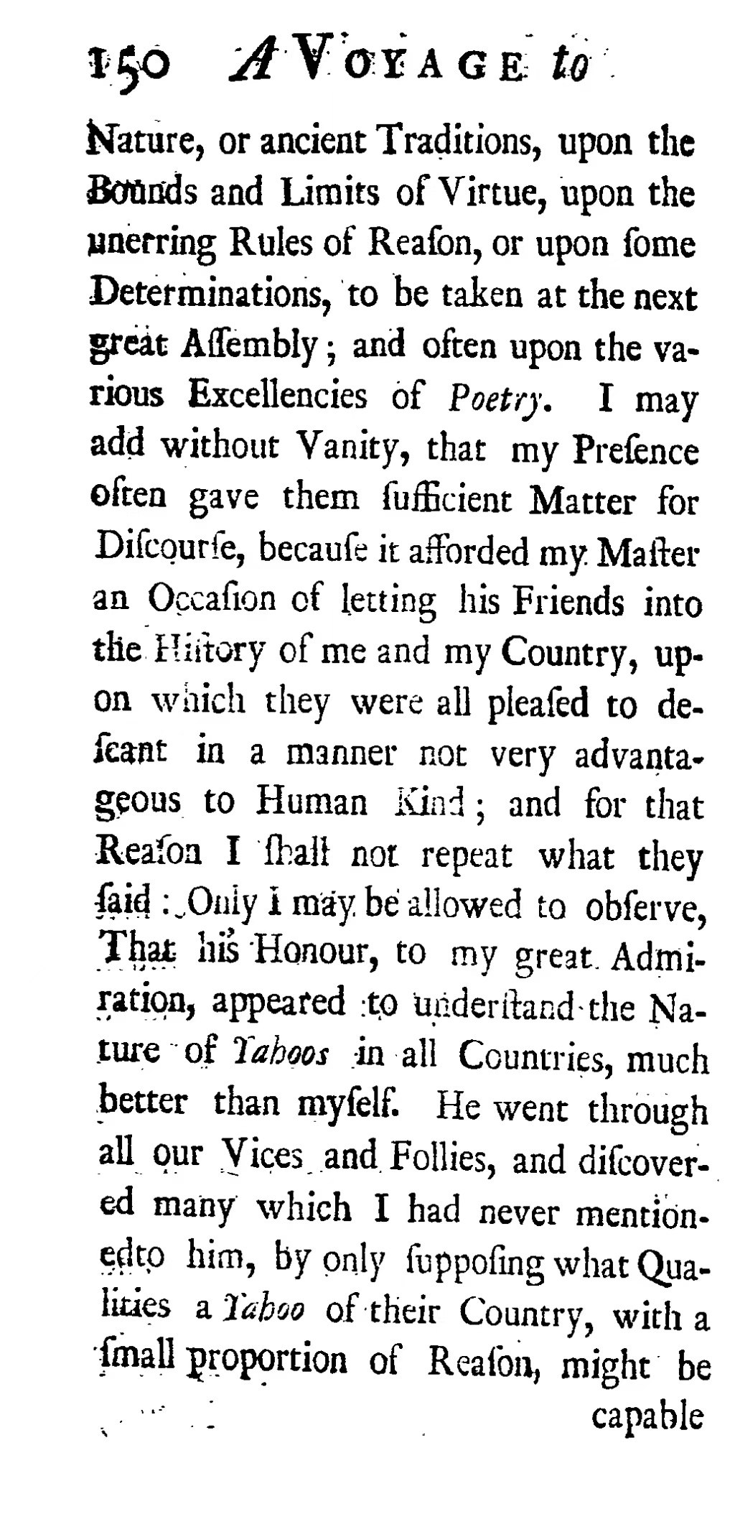
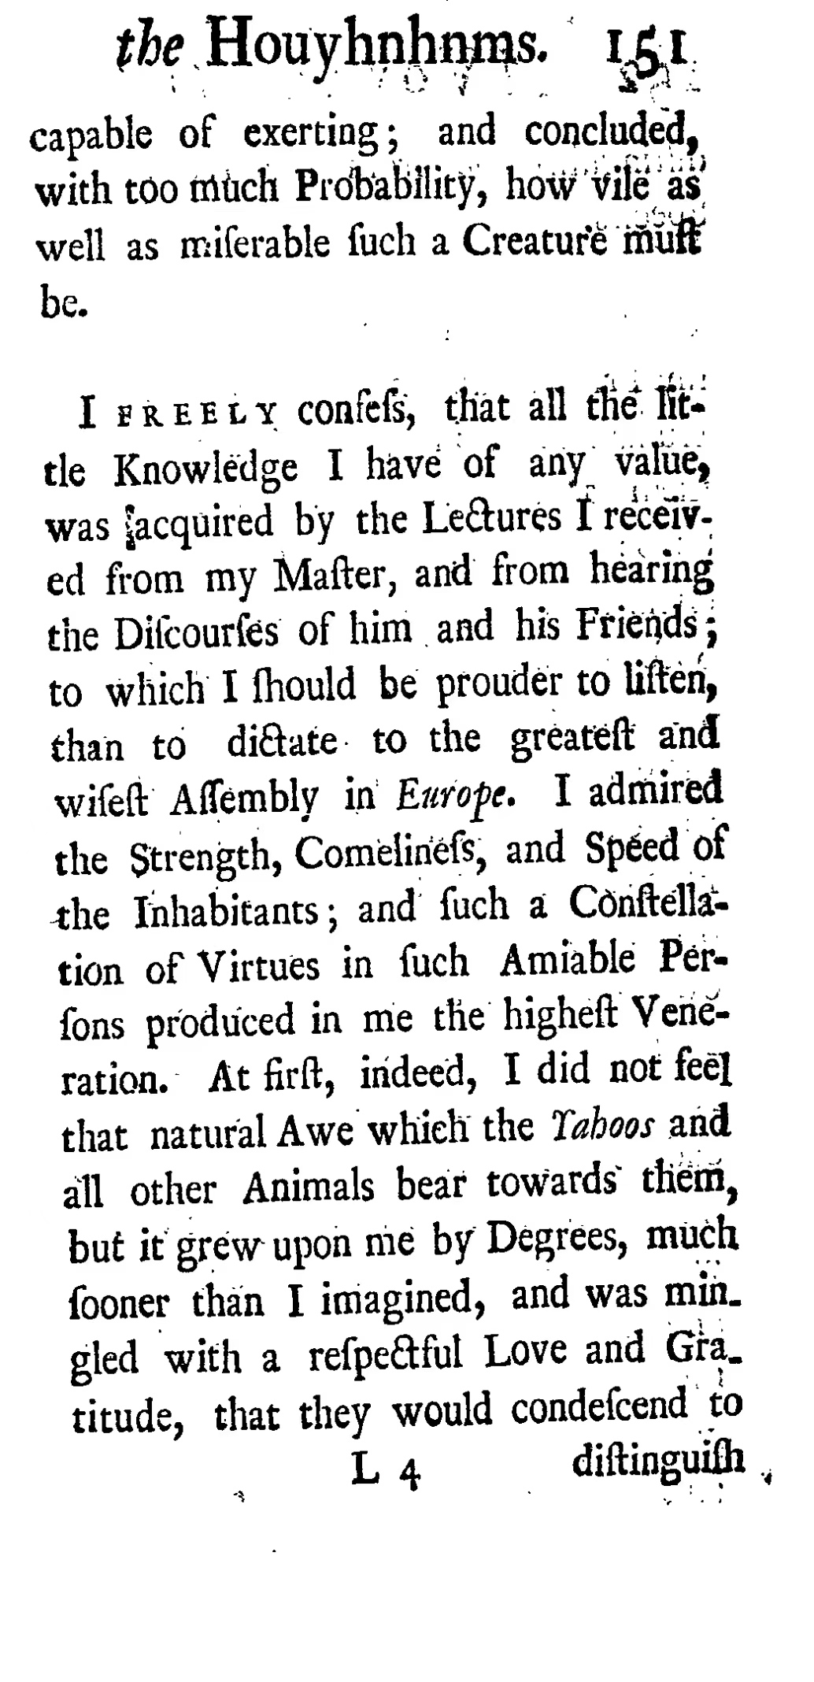
Content introduction
P150-151

Slide 8
Content introduction
P150-151
His presence enabled other Houyhnhnms to argue more about another culture.

Slide 9
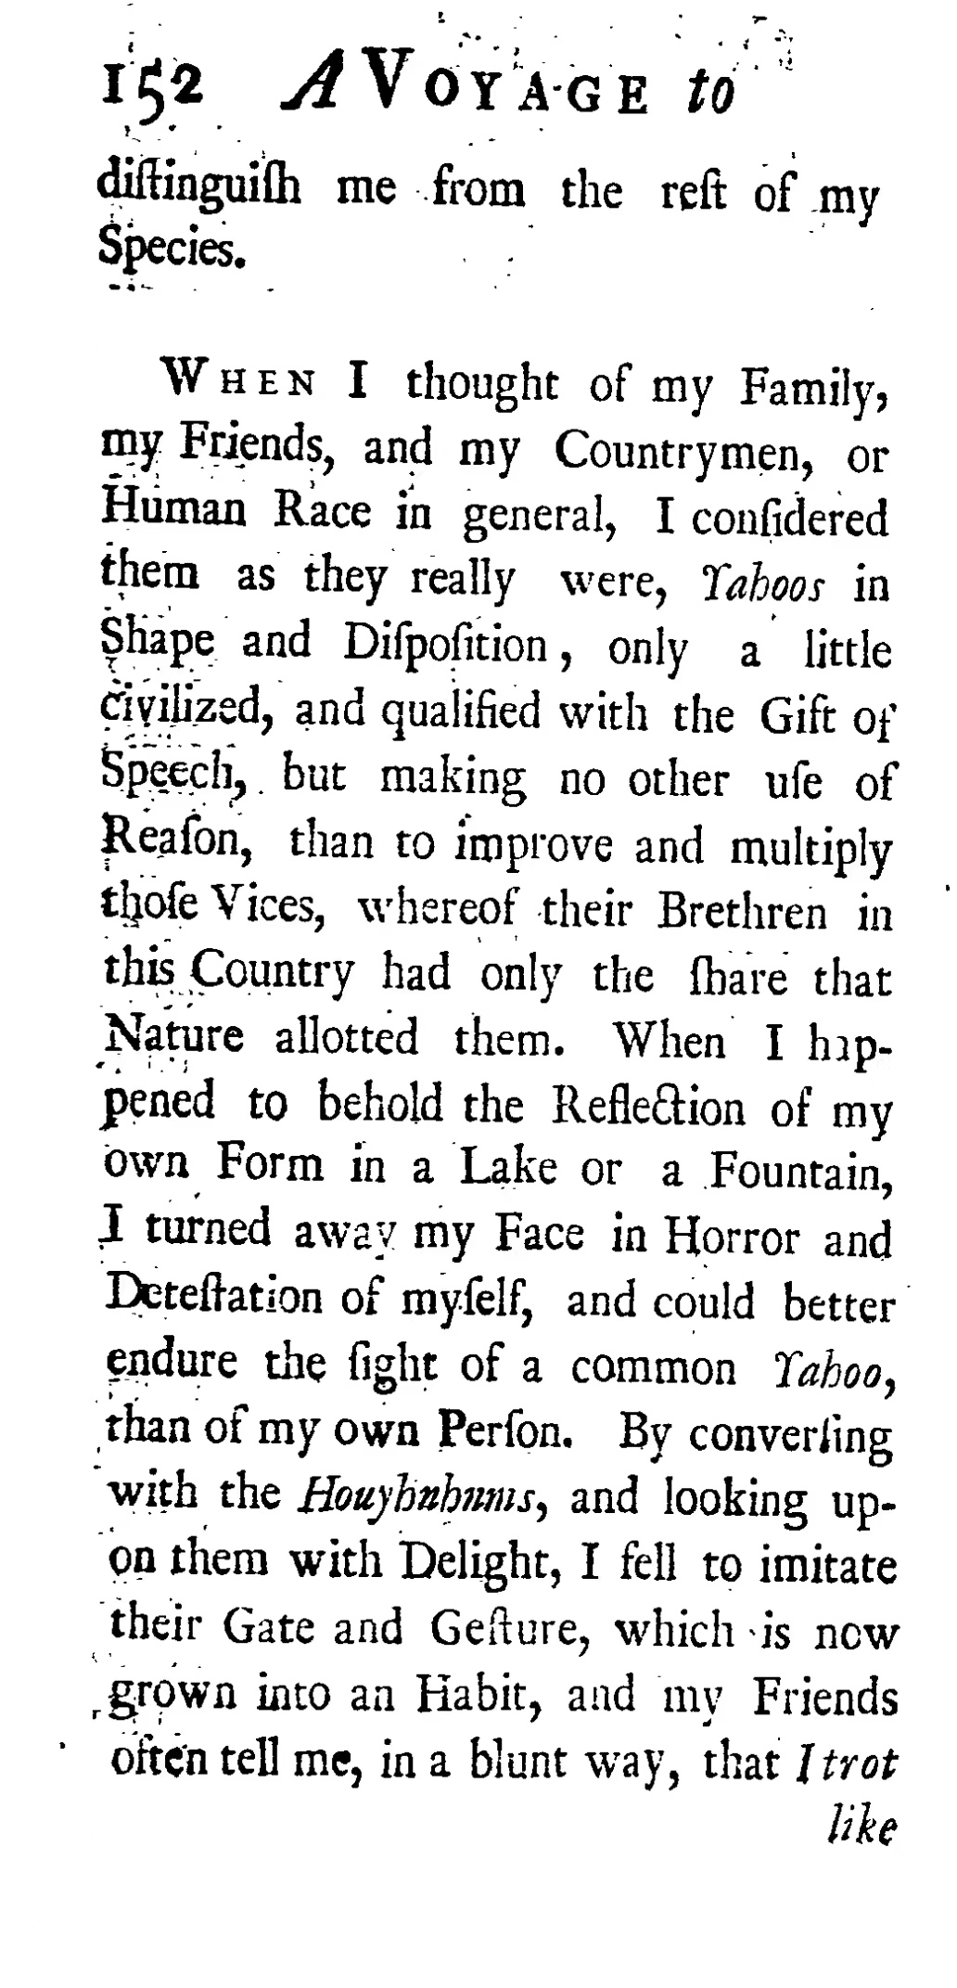
Content introduction
P152
a horse

Slide 10
Content introduction
P152
Gulliver had a strong sense of belonging to the Houyhnhnms.
a horse

Slide 11
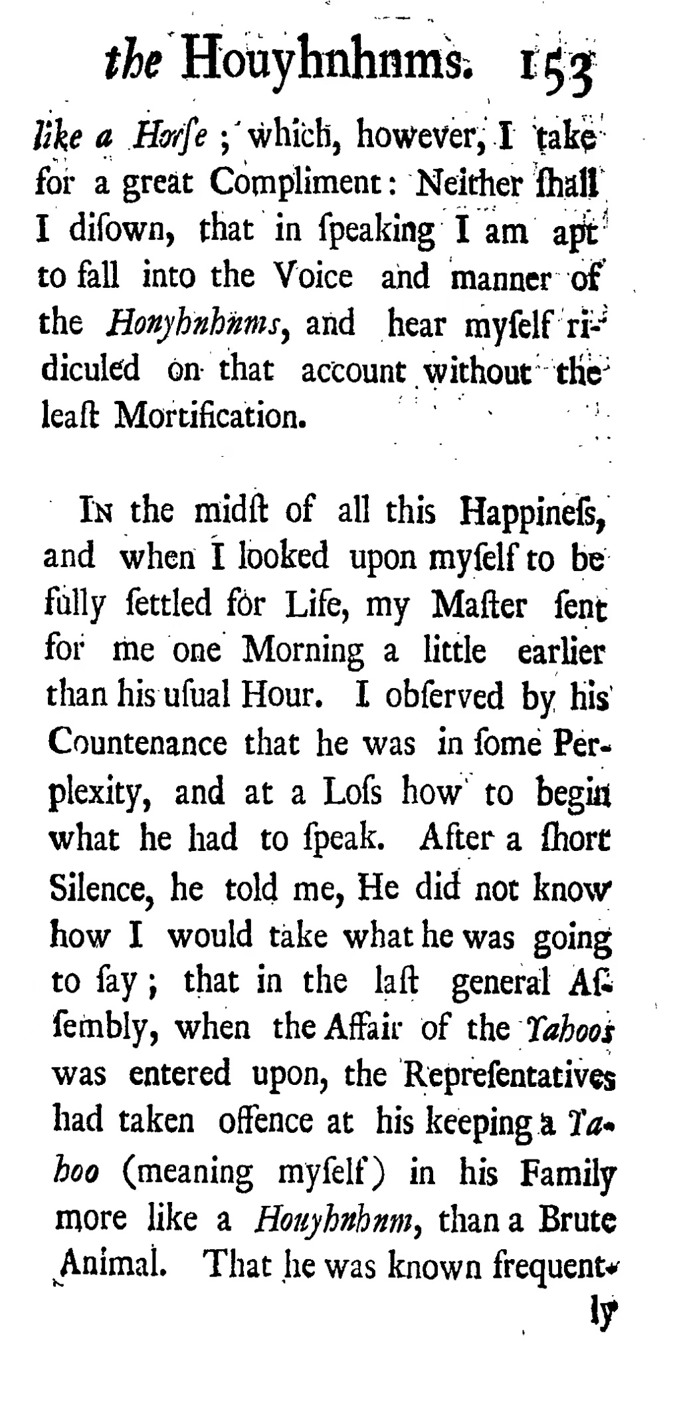
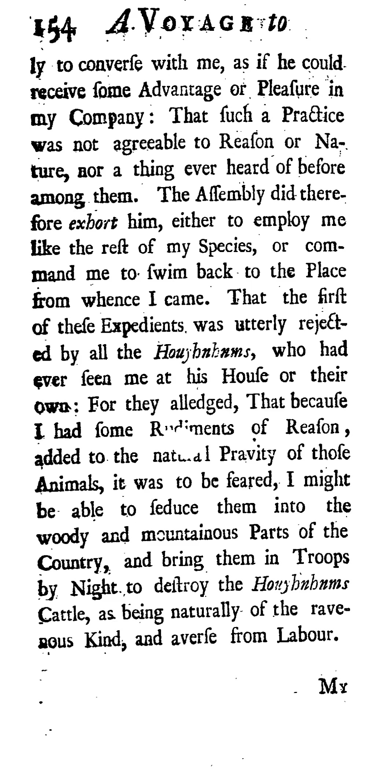
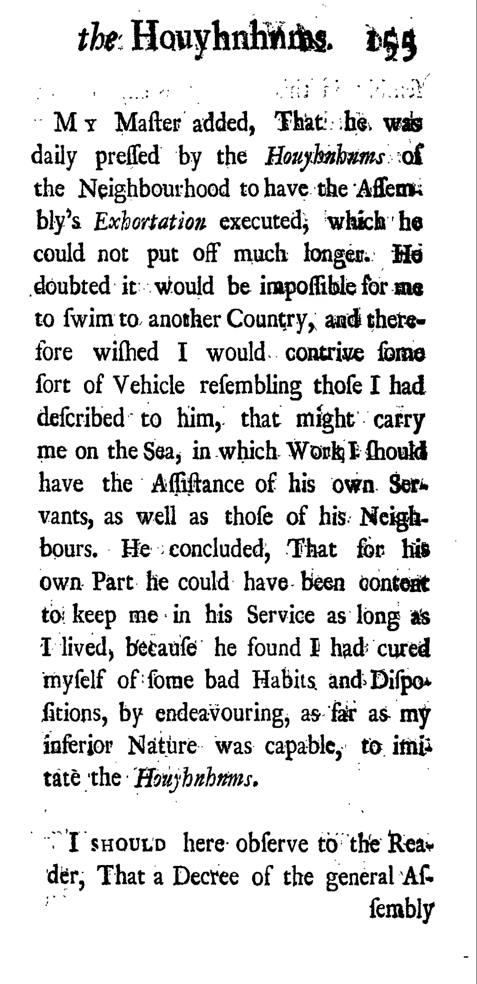
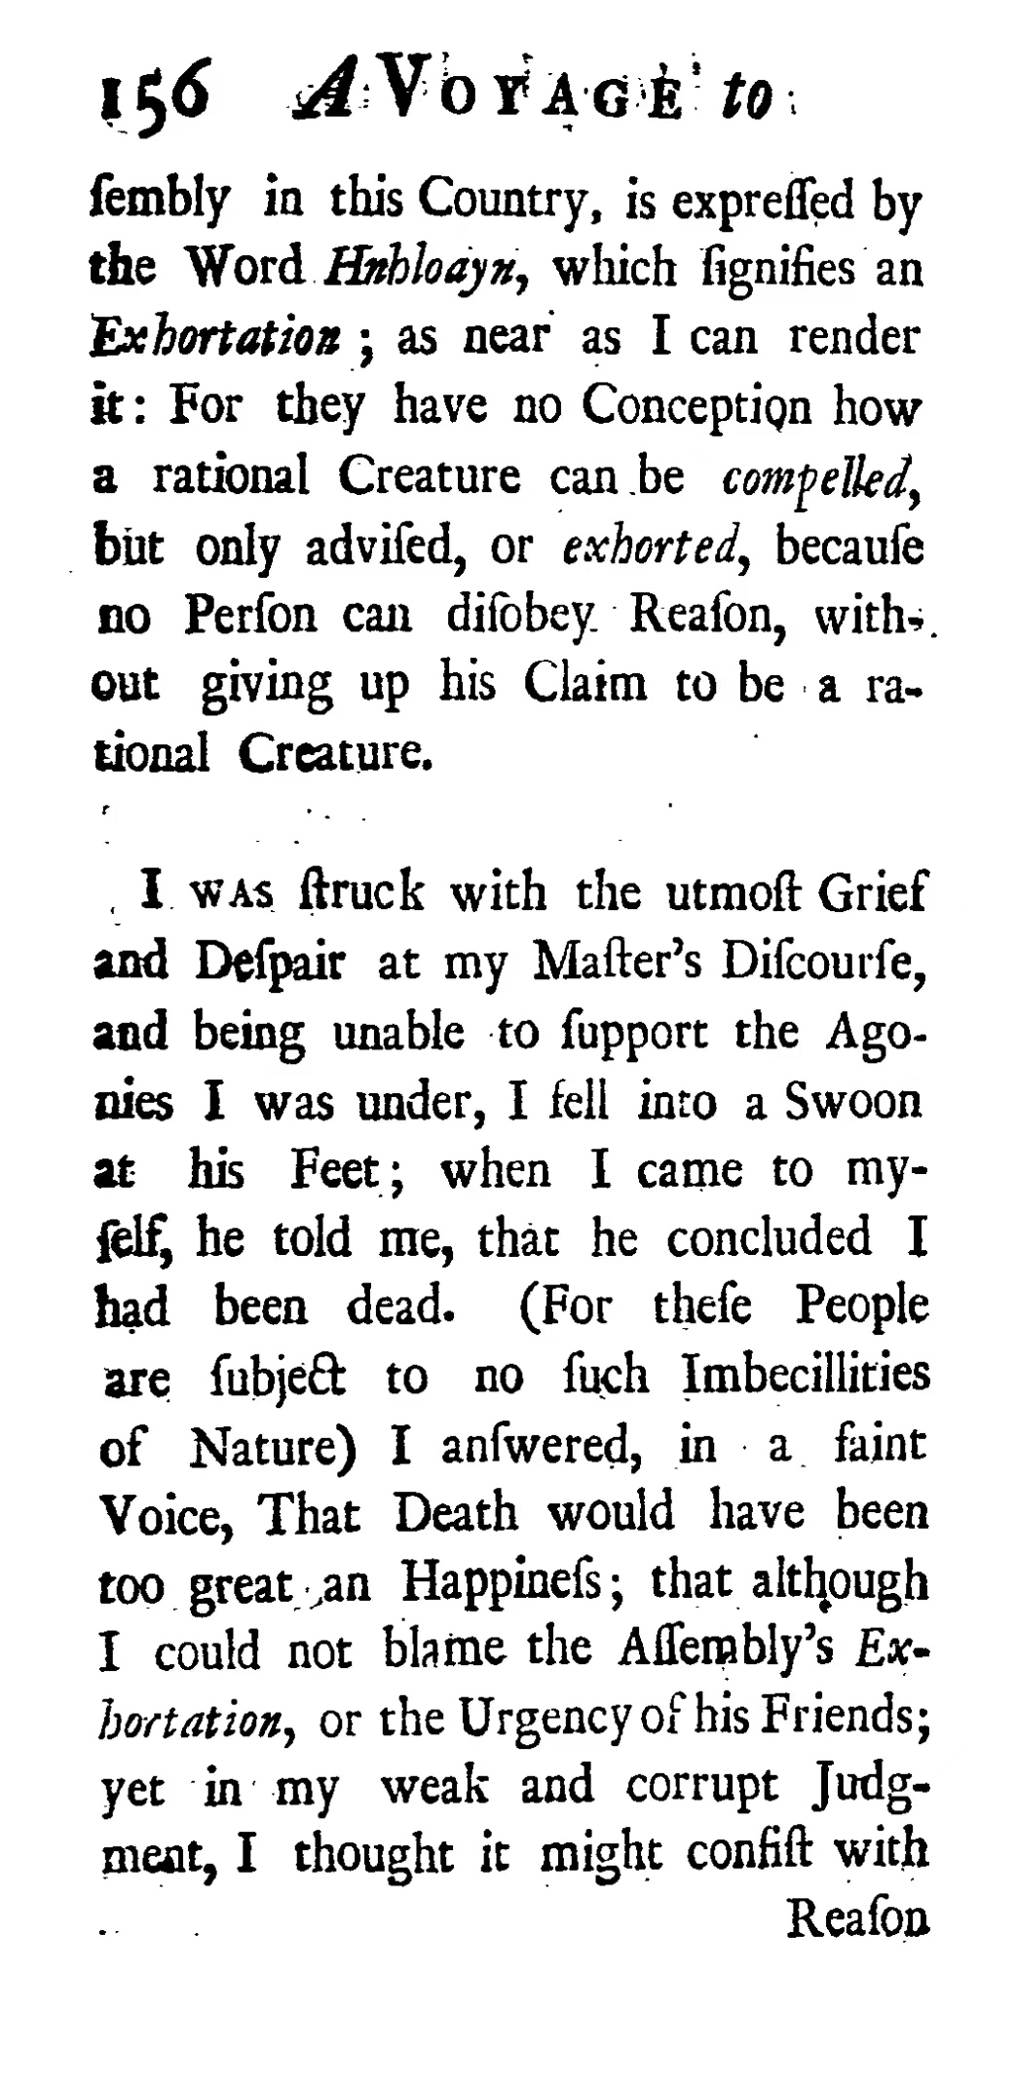
Content introduction
P153-156

Slide 12
Content introduction
P153-156
Gulliver were forced to leave the Houyhnhnms because his master’s neighbors thought it wrong to keep a Yahoo in his family. After knowing this, Gulliver was struck with grief and despair but he accepted it at last.

Slide 13
02
Related with
the supplementary materials?
A VOYAGE to the Houyhnhnms Chapter X p.147-156

Slide 14
Multiculturalism and cultural difference
External cognition

Slide 15
Multiculturalism and cultural difference
The most direct difference between human society and Houyhnhnms is the recognition of the higher-status species and the relatively lower-status species.

Slide 16
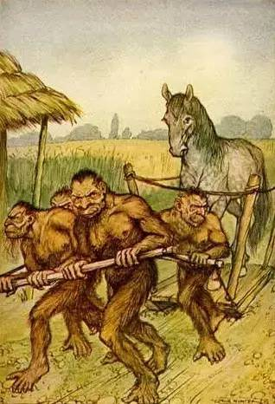
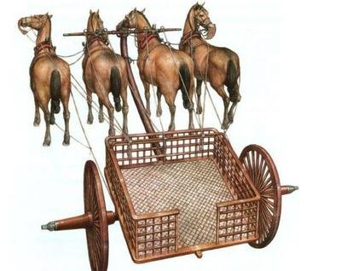
Multiculturalism and cultural difference
The most direct difference between human society and Houyhnhnms is the recognition of the higher-status species and the relatively lower-status species.
Cognitive reversal

Slide 17
Multiculturalism and cultural difference
The most direct difference between human society and Houyhnhnms is the recognition of the higher-status species and the relatively lower-status species.
Gulliver’s sense of cultural superiority
cut down
Cognitive reversal

Slide 18
Multiculturalism and cultural difference
The most direct difference between human society and Houyhnhnms is the recognition of the higher-status species and the relatively lower-status species.
People & People
Human & Horse

Slide 19
Multiculturalism and cultural difference
External cognition
Individual conduct

Slide 20
Multiculturalism and cultural difference
Compared with human’s complex emotions, the species in Houyhnhnms were endowed with absolute rationality and barbarism.

Slide 21
Multiculturalism and cultural difference
Compared with human’s complex emotions, the species in Houyhnhnms were endowed with absolute rationality and barbarism.
‘The Yahoos turn out to be Gulliver’s worst nightmare: human beings devoid of reason and without a trace of fellow feeling for each other. The contrast with the calm and well-adjusted – if admittedly cold and somewhat self-satisfied – Houyhnhnms is stark.’

Slide 22
Multiculturalism and cultural difference
Compared with human’s complex emotions, the species in Houyhnhnms were endowed with absolute rationality and barbarism.
‘The Yahoos turn out to be Gulliver’s worst nightmare: human beings devoid of reason and without a trace of fellow feeling for each other. The contrast with the calm and well-adjusted – if admittedly cold and somewhat self-satisfied – Houyhnhnms is stark.’
Houyhnhnms
evolution
degradation
Yahoos

Slide 23
Multiculturalism and cultural difference
Compared with human’s complex emotions, the species in Houyhnhnms were endowed with absolute rationality and barbarism.
‘I must freely confess, the Sight of them filled me only with Hatred, Disgust and Contempt; . . . And when I began to consider, that by copulating with one of the Yahoo-Species, I had become a Parent of more; it struck me with the utmost Shame, Confusion and Horror.’

Slide 24
Multiculturalism and cultural difference
Compared with human’s complex emotions, the species in Houyhnhnms were endowed with absolute rationality and barbarism.
‘I must freely confess, the Sight of them filled me only with Hatred, Disgust and Contempt; . . . And when I began to consider, that by copulating with one of the Yahoo-Species, I had become a Parent of more; it struck me with the utmost Shame, Confusion and Horror.’
assimilate into Houyhnhnms culture

Slide 25
Multiculturalism and cultural difference
External cognition
Individual conduct
Internal cognition

Slide 26
Multiculturalism and cultural difference
The contradiction that Gulliver finally alienated other people results from the change in his world view through the acceptance of Houyhnhnms culture.

Slide 27
Multiculturalism and cultural difference
The contradiction that Gulliver finally alienated other people results from the change in his world view through the acceptance of Houyhnhnms culture.
pose an inner conflict

Slide 28
Multiculturalism and cultural difference
External cognition
Individual conduct
Internal cognition

Slide 29
03
Feelings and comments on Chapter 4:
A VOYAGE to the Houyhnhnms Chapter X p.147-156

Slide 30
An introduction to Gulliver's Travels
——A sharp appeal to reason
in a time of chaotic
黄一凡 程含章
2022/10/18

Slide 31
Some feelings and comments on Chapter 4
From the positive side,
The Houyhnhnms is rational, wise, hardworking, brave, kind and friendly, (all the ideal of humanity) , which pose sharp satires on the lack of reasons of the British or even the whole human race, and on their partisanship in the war of cultural conflict, by Swift’s outstanding literary writing skills.
“ I don't write to please people; I write to annoy people. ” —— Swift
From the negative side,
Gulliver's inability to fit in when he came back to England, together with some details in Houyhnhnms’ social operation, make me associate with what a sociologist Hayek said, namely “The Fatal Conceit of Reason”.

Slide 32
positive side
Swift’s outstanding literary writing skills
①
“ Swift enriches the moral connotation of the work with his humor, and also exposes the absurd with satire. ”
——Walter Scott
Direct satire
① Humorous words
② Sarcastic statements
Indirect satire
②
“ He makes the incredible events be the truths through…… ”
——Walter Scott
①Detailed illustration
② Realistic words

Slide 33
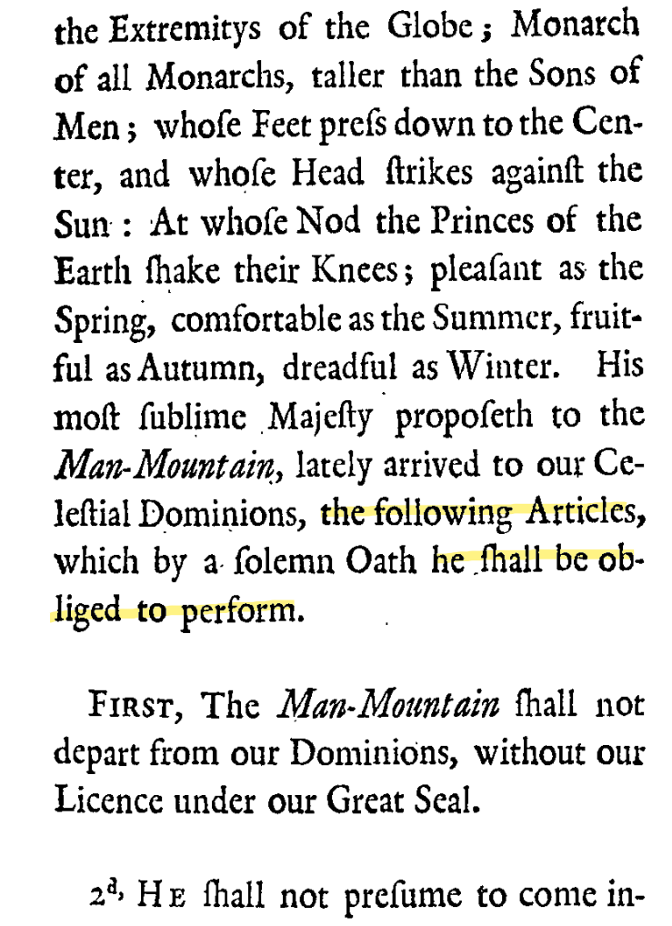
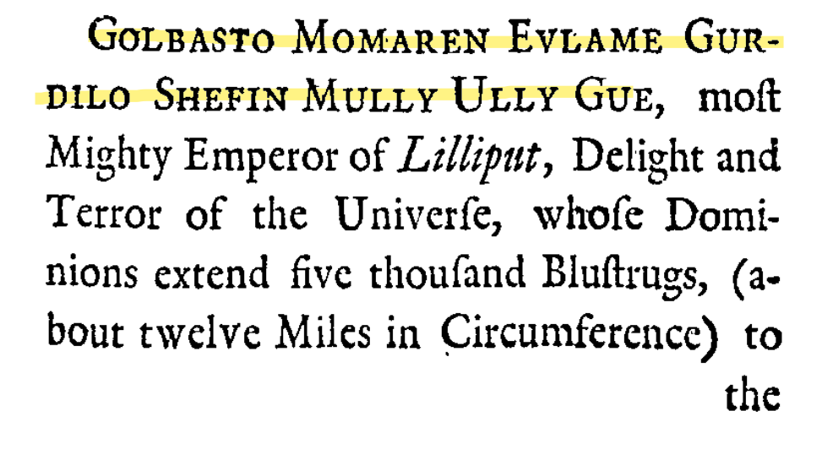
①
positive side
Humor and satire
① Humorous words
The full name of the king
The only useful words
The exaggerated title and boast of the king
P 59 - 60

Slide 34
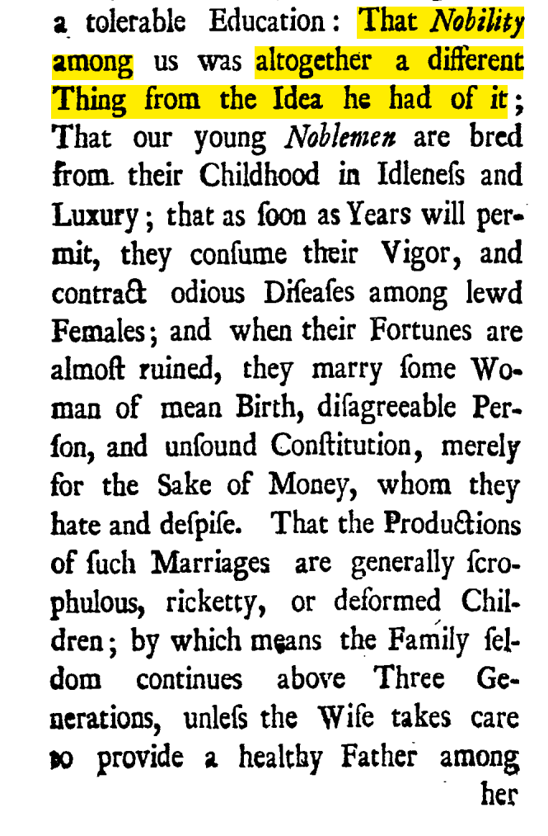
①
positive side
Humor and satire
② Sarcastic statements
Direct satire
Nobilities in England took pride in their weakness
and thought that a strong body was an unfortunate
result of doing too much labor work.
Young nobilities were lacking in health and vigor.
P 59 - 60

Slide 35
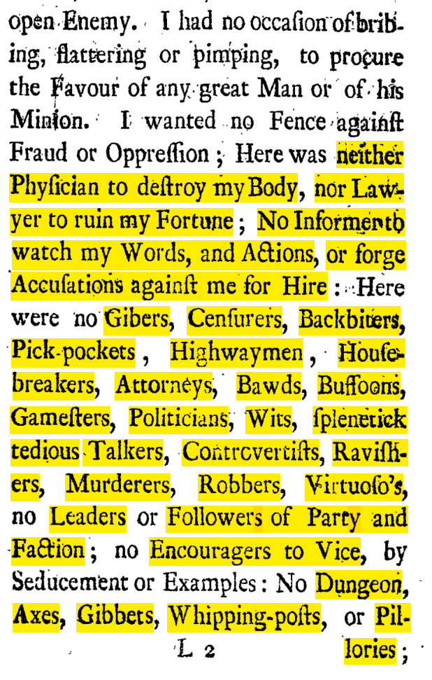
①
positive side
Humor and satire
② Sarcastic statements
Parallel sentence/enumerate
Various of people with bad manner in England at that time
P 96

Slide 36
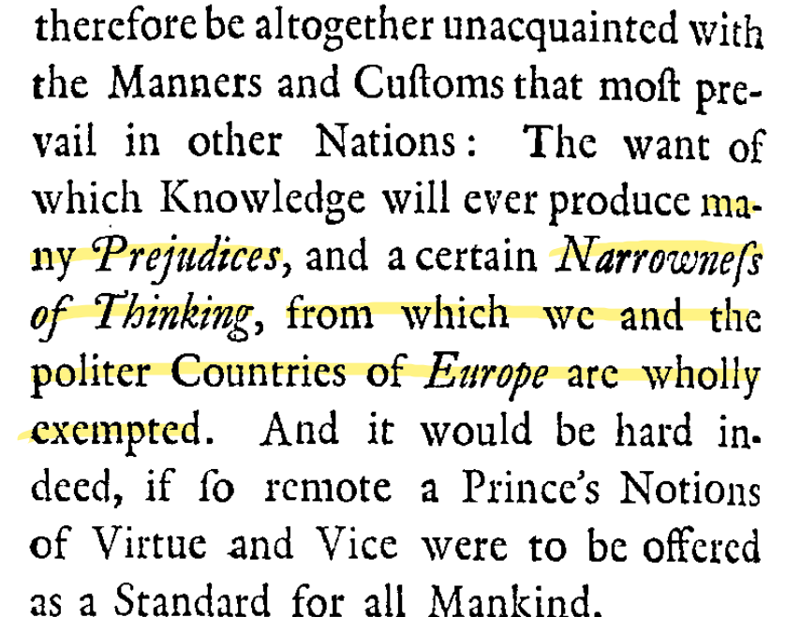
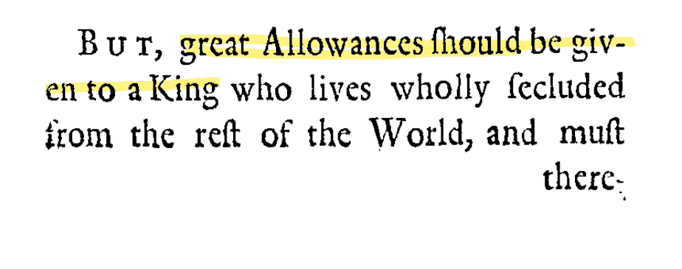
①
positive side
Humor and satire
② Sarcastic statements
“I should be tolerant to the King’s
prejudices and narrowness. After all,
he is not a European, no wander he
has such bad manners. ”
Indirect satire
Satirizing the arrogance of Europeans at the time

Slide 37
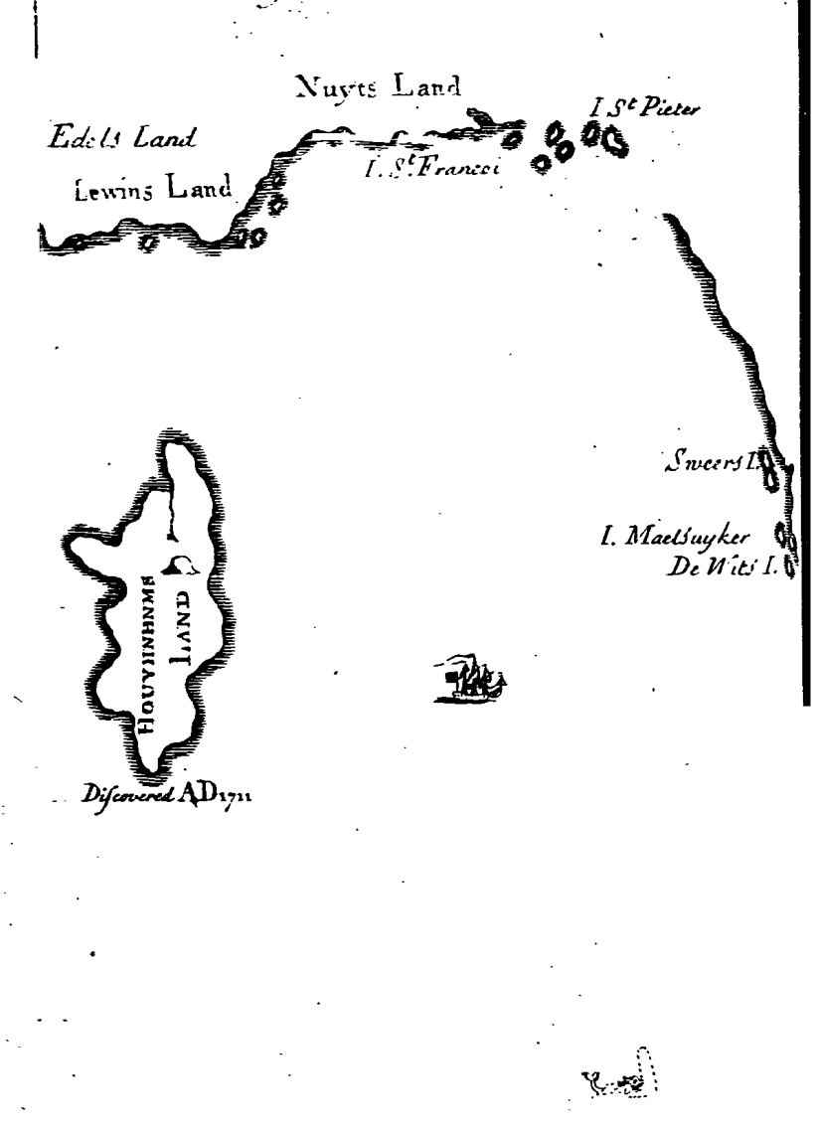
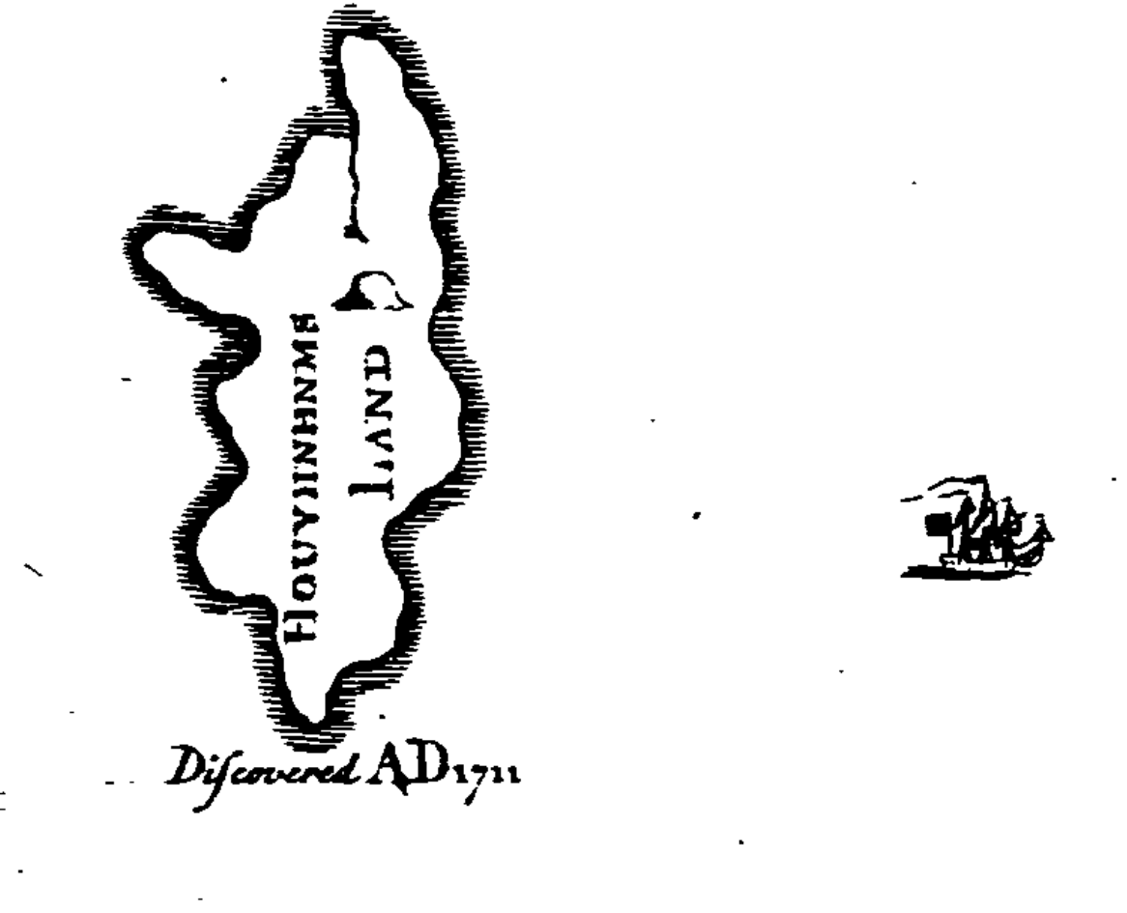
②
positive side
Make events be the truths
①Detailed illustration
P 1

Slide 38
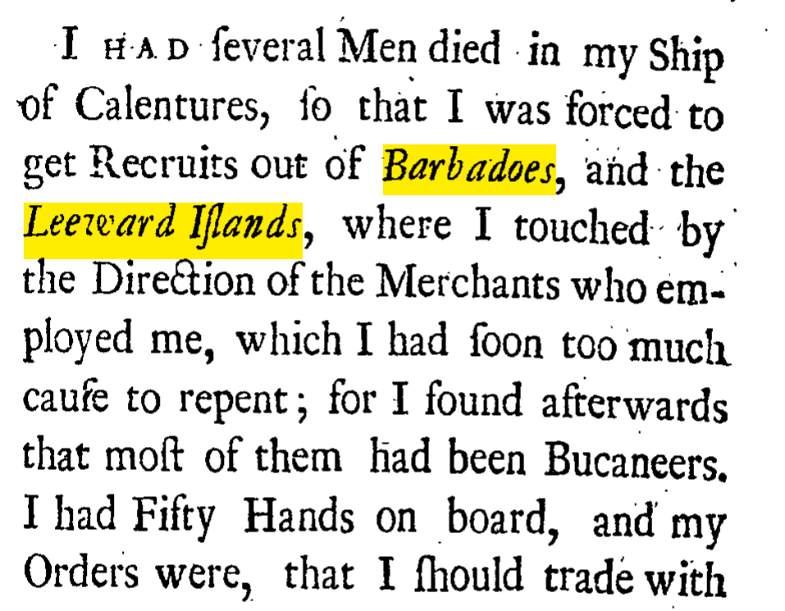
②
positive side
Make events be the truths
② Realistic words
P 3

Slide 39
positive side
Conclusions
The satire of Gulliver's travels is serious, sharp and caustic, but it is not a desperate mockery or boring sarcasm, but to expose the truth, analyze the root cause, and promote people’s reflection and improvement.

Slide 40
positive side
Why does Swift have such a dissatisfaction
with the English bourgeoisie and even the whole England in Gulliver's Travels ,
while Defoe speaks highly of the English bourgeoisie in Robinson Crusoe ?
(Btw, these two authors are cotemporary,
and Swift was merely 7 years smaller than Defoe. )

Slide 41

Swift’s early experience VERSUS Defoe’s
Swift’s childhood
Defoe’s childhood

Slide 42
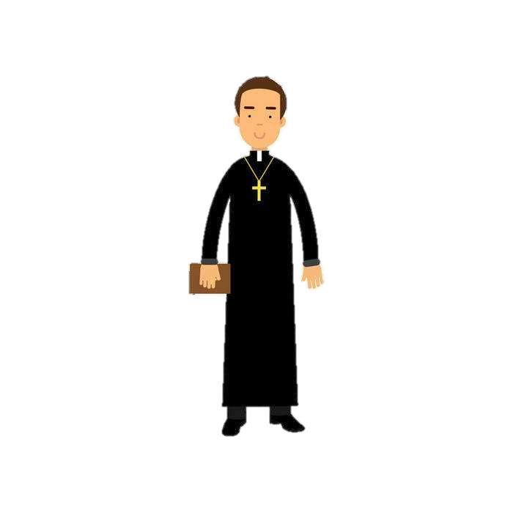
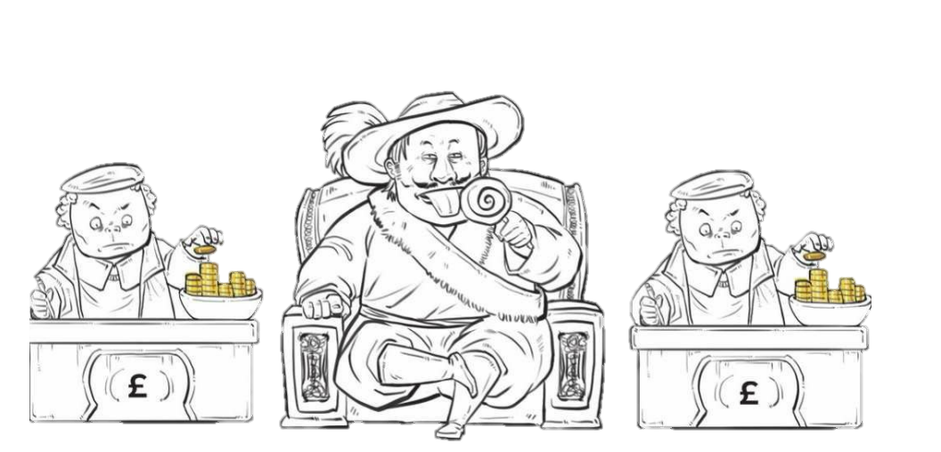
Swift’s early experience VERSUS Defoe’s
Swift’s work
Defoe’s work
Be proud of this occupation
∴ Against English bourgeoisie
∴ Support English bourgeoisie

Slide 43
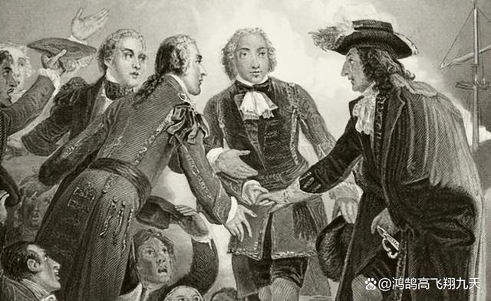
Swift’s early experience VERSUS Defoe’s
Swift’s politics status
Defoe’s politics status
Tory Party
Whig Party
On the side
of nobility
Forbidden
transnational
trades
On the side
of bourgeoisie
Support
transnational
trades
∴ Against English bourgeoisie
∴ Support English bourgeoisie

Slide 44
Swift’s early experience VERSUS Defoe’s
Swift’s politics status
Defoe’s politics status
Tory Party
Whig Party
On the side
of nobility
Forbidden
transnational
trades
Win!
On the side
of bourgeoisie
Support
transnational
trades
“The period known as the Whig Supremacy (1714–1760) was enabled by the Hanoverian succession of George I in 1714 and the failure of the Jacobite rising of 1715 by Tory rebels. The Whigs took full control of the government in 1715 and thoroughly purged the Tories from all major positions in government, the army, the Church of England, the legal profession and local political offices. ”
—— Holmes, Geoffrey; and Szechi, D. (2014). The Age of Oligarchy: Pre-Industrial Britain 1722–1783. Routledge. p. xi. ISBN 131789426X. ISBN 978-1317894261.

Slide 45
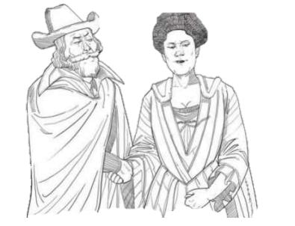
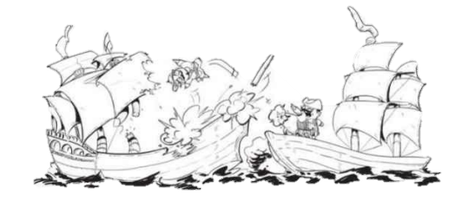
Swift’s early experience VERSUS Defoe’s
Swift’s politics status
Swift lost in political struggle,
Tory Party
But his previous involvement in party battles has broaden his horizon to more problems in England.
In Britain
Around the World
In England
∴ Dissatisfaction with England
· Oppression
towards Ireland
· Led to the death of
1/3 population of Irish
·Also, Swift is an Irish.
·Started wars with French
and Netherland
for treasure, throne
and control of ship route.
· Political struggle
· Erosion of public morals
· Lack of reasons (logoi)

Slide 46
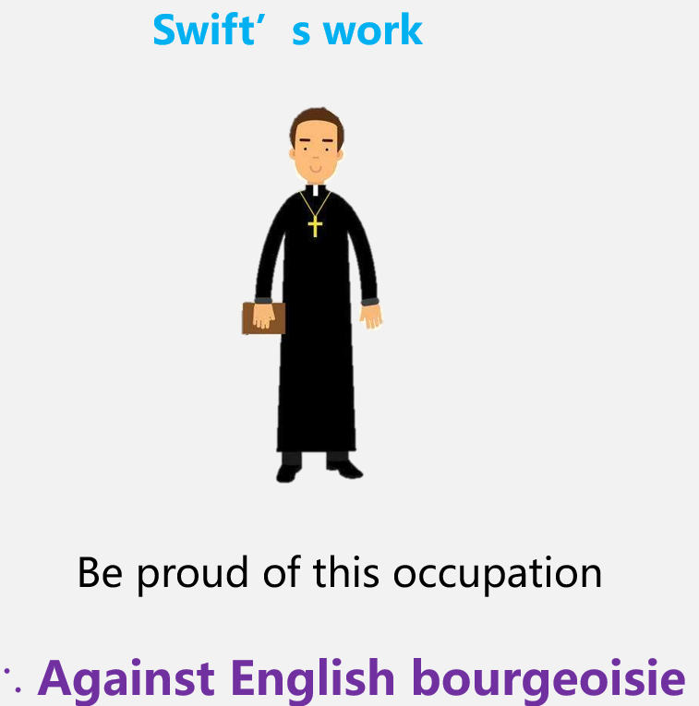
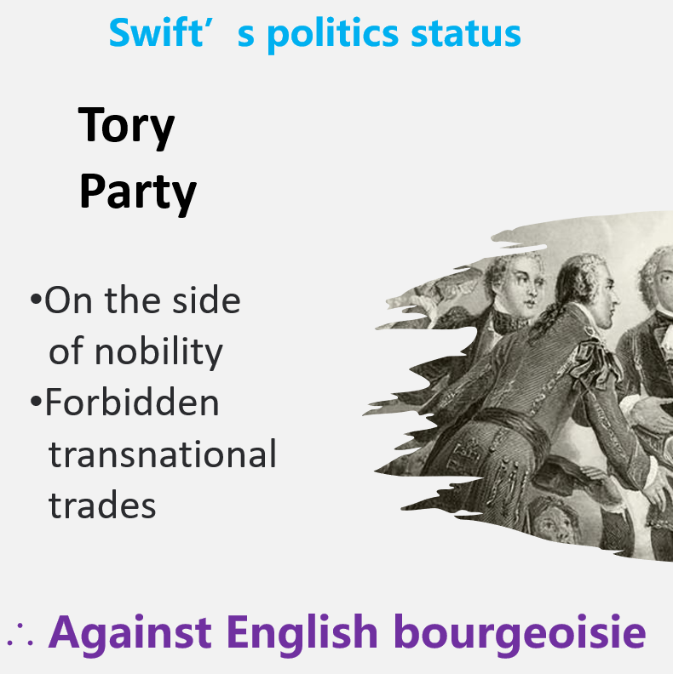
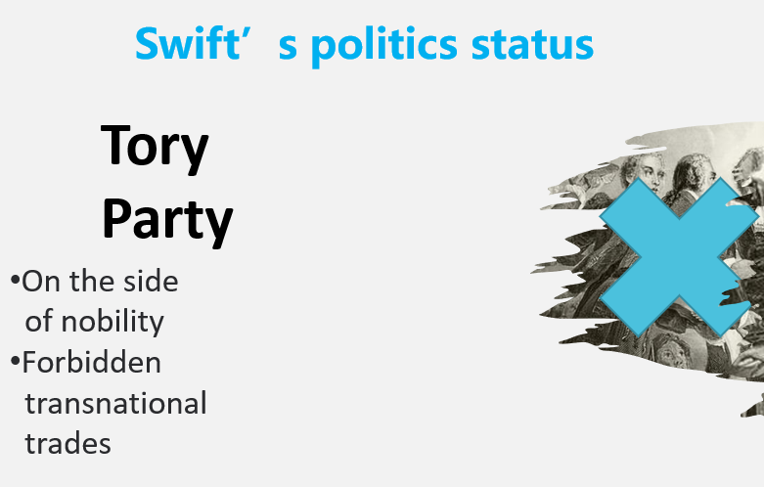
Conclusions
It is Swift’s occupation experience and politics status that makes him against English bourgeoisie.
It is Swift’s failure in politics struggle that triggers his reflection on the problems existed in the empire, thus bring about his criticism of England.

Slide 47
A sharp appeal to reason in a time of chaotic
From the positive side,
The Houyhnhnms is rational, wise, hardworking, brave, kind and friendly, (all the ideal of humanity) , which pose sharp satires on the lack of reasons of the British or even the whole human race, and on their partisanship in the war of cultural conflict, by Swift’s outstanding literary writing skills.
“ I don't write to please people; I write to annoy people. ” —— Swift
From the negative side,
Gulliver's inability to fit in when he came back to England, together with some details in Houyhnhnms’ social operation, make me associate with what a sociologist Hayek said, namely “The Fatal Conceit of Reason”.
Swift create a race called Houyhnhnm.
Their great principle is to cultivate reason. Everything in that society is governed by reason.
By contrast, Yahoos pursue the satisfaction of all kinds of desire, and have no rules or restrictions of ethics, just like people at that time.
So, Swift wish the people become reasonable, thus creating a fully reasonable society.
Does this absolutely rational society turn out to be perfect from a contemporary point of view?

Slide 48
1. A rigidly stratified society
negative side
Gulliver‘s master in Houyhnhnm-land tells Gulliver that his kind have an equal affection for all young Houyhnhnms, and that Nature teaches them to love the whole of their species ——？
White, Sorrel and Iron-grey
1
Bay, Dapple-gray, Black
(have no birth restriction, so as to
generate more servants for the
upper grade)
2
( Gulliver )
3
4
Yahoo

Slide 49
2. The lack of emotion and awe of life
negative side
The dying Houyhnhnms do not at all regret that they are leaving the world.
They only behave like a neighbour who has just visited and is going home.
The relatives and friends of the dead expressed neither joy nor sorrow.

Slide 50

Thanks for listening
[1]Swift, Jonathan. Travels into several remote nations of the world. In four parts. By Lemuel Gulliver, first a surgeon, and then a captain of several ships. ... Vol. 1. London: printed for Benj. Motte, at the Middle Temple-Gate in Fleet-Street, MDCCXXVI. [1726].
[2]Holmes, Geoffrey; and Szechi, D. (2014). The Age of Oligarchy: Pre-Industrial Britain 1722–1783. Routledge. p. xi. ISBN 131789426X. ISBN 978-1317894261.

